Slide 1
Spatial filter sharpening technique

Slide 2
Agenda
1D sharpening filter
First order derivative
Second order derivative
2D sharpening filter
Laplacian filter
Simplified filter
Unsharp filter
High boost filter
Sobel filter
Notes:
Momen 1D all
M8raby laplacian
Badr simple
Amr unshrap
Ismail high
Abdo sobel

Slide 3

1D sharpening filter

Slide 4
Small brief of 1st & 2nd Derivatives
1st & 2nd Derivatives
Comparing the 1st and 2nd derivatives we can conclude the following:
1st order derivatives generally produce thicker edges.
2nd order derivatives have a stronger response to fine detail e.g. thin lines.
1st order derivatives have stronger response to grey level step.
2nd order derivatives produce a double response at step changes in grey level

Slide 5
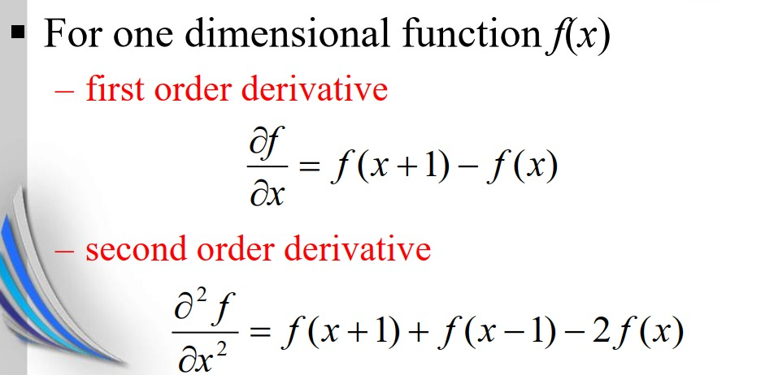
Law of 1d derivative

Slide 6
Example of 1d derivative
Example: make the 1D with first and second derivative of the following
4,4,3,3,2,2,2,1,1,1,5,5,5,3,3,7,7,7,6,6,6,6
Law:-
First order derivative of ( df / дх ) = f(x+1) - f (x)
Solution:-
First Derivative: 0,−1,0,−1,0,0,−1,0,0,4,0,0,−2,0,4,0,0,−1,0,0,0
Law:-
second order derivative (d² f/ дх² ) = f(x+1)+f(x-1)-2 f(x)
Solution:-
Second Derivative: −1,1,−2,1,−1,0,0,3,−3,0,0,−2,2,0,2,−3,1,−1,0,0,0

Slide 7
2D sharpening filter

Slide 8
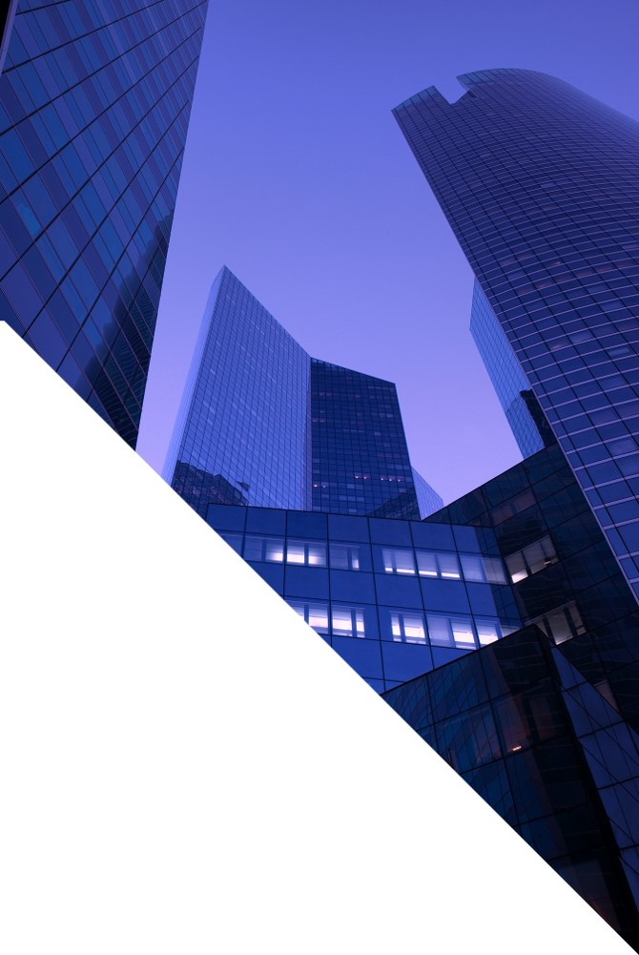
Laplacian filter

Slide 9
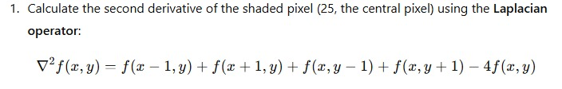
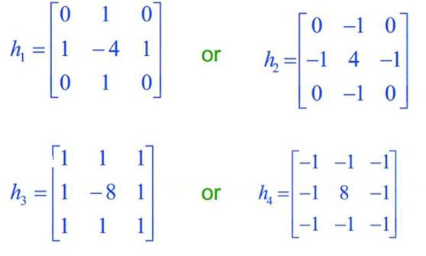
Laplacian filter law
The mask of Laplacian must equal to zero
It is edge detection

Slide 10
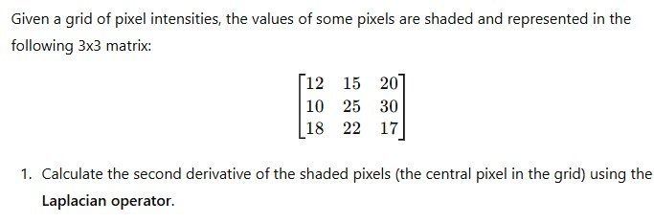
Laplacian filter example

Slide 11
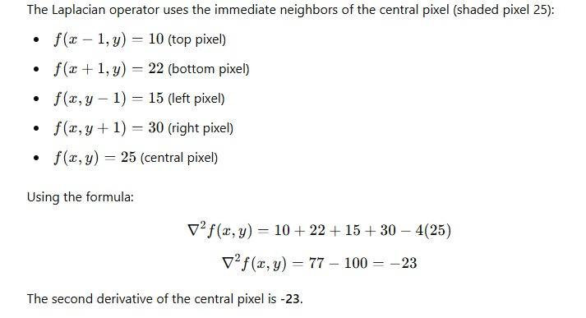
Laplacian filter solution
25 - 23 = 2

Slide 12
Simplified or composed filter

Slide 13
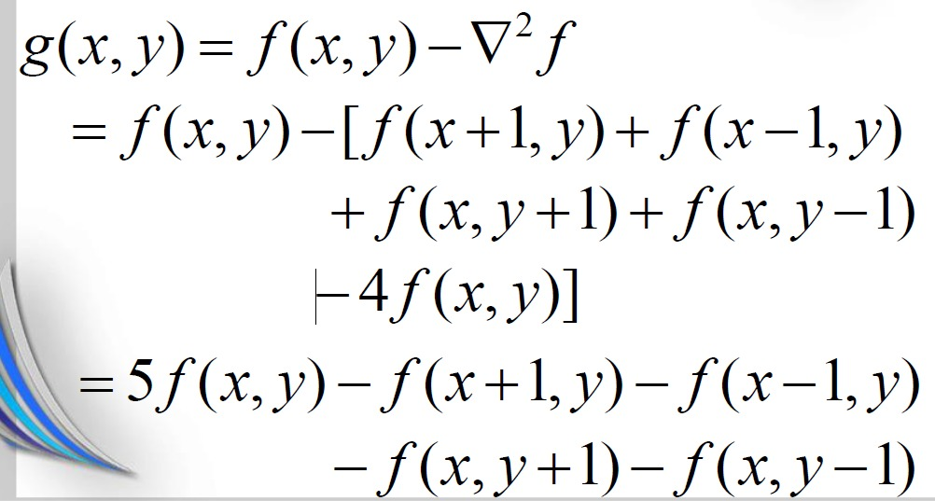
Simplified filter law

Slide 14
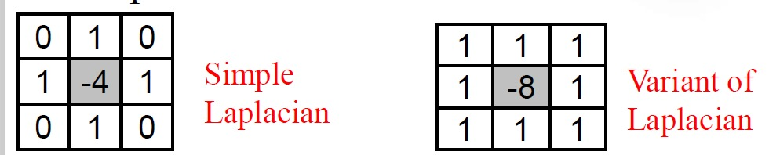
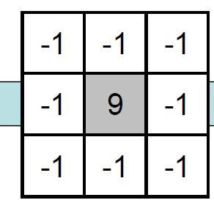
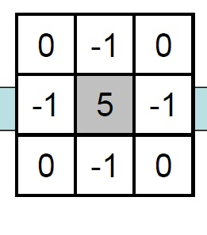
Simplified filter mask
Simple composed Laplacian
Variant composed Laplacian

Slide 15
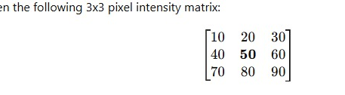
Simplified filter Example

Slide 16
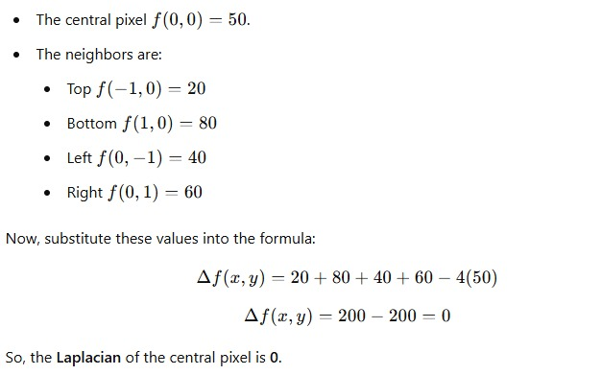
Simplified filter solution

Slide 17
Unshaped filter

Slide 18
Unshaped filter law
Unsharp Masking Filtering:-
Sharpen images consists of subtracting an unsharp (smoothed) version of an image from the original image.
Steps of Unsharp Masking:-
Blur the original image.
Create the unsharp mask using subtract the blurred image from the original
Add this mask to the original.

Slide 19
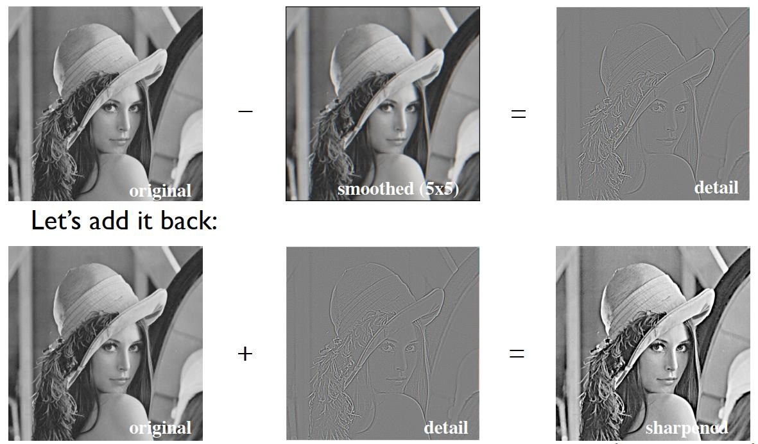
Unshaped filter Steps

Slide 20
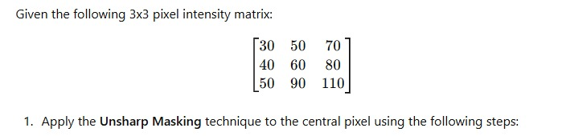
Unshaped filter Example

Slide 21
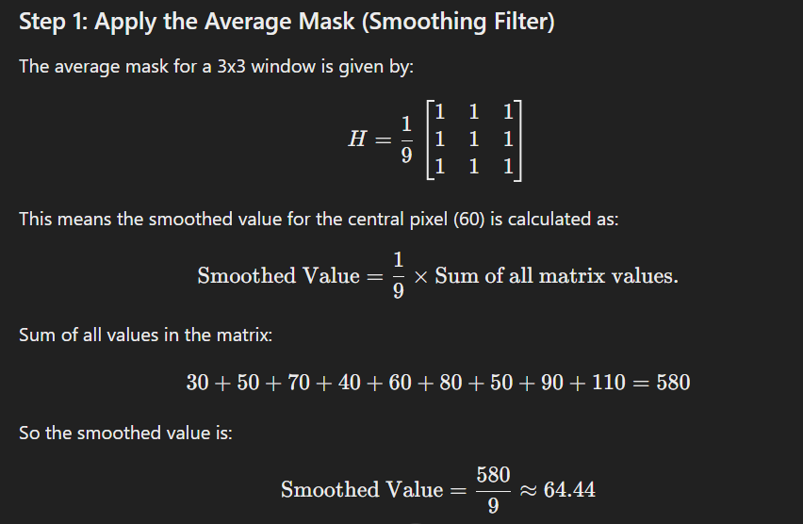
Unshaped filter Example

Slide 22
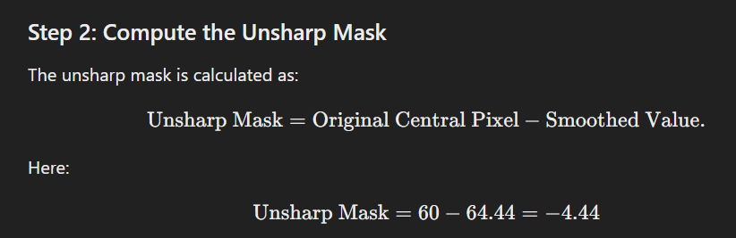
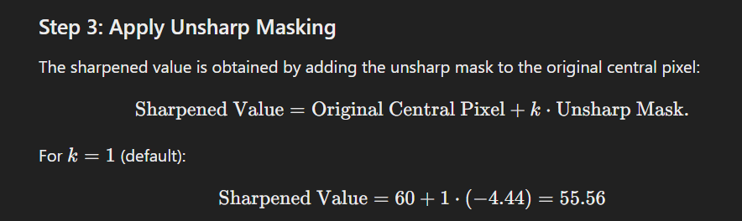
Unshaped filter Example

Slide 23
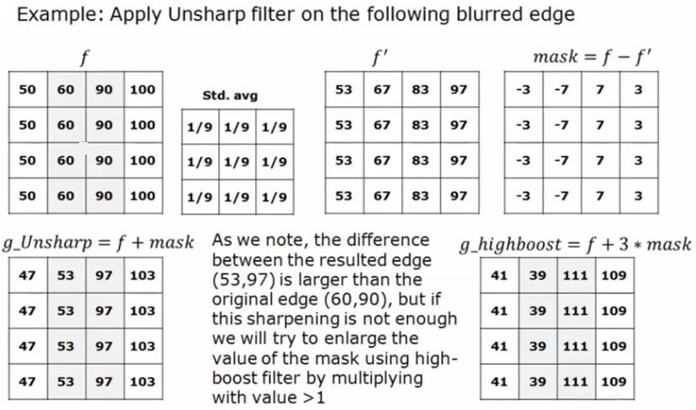
Unshaped filter Solution

Slide 24
High boost filter

Slide 25
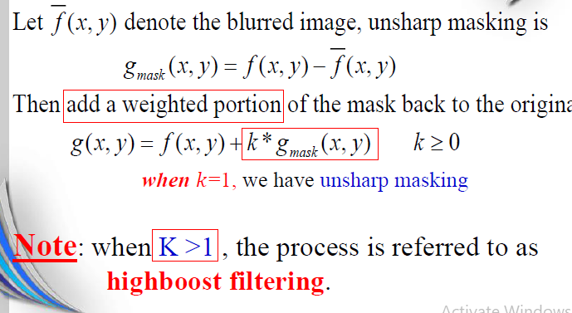
High boost filter steps

Slide 26
High boost filter steps
High Boost

Slide 27
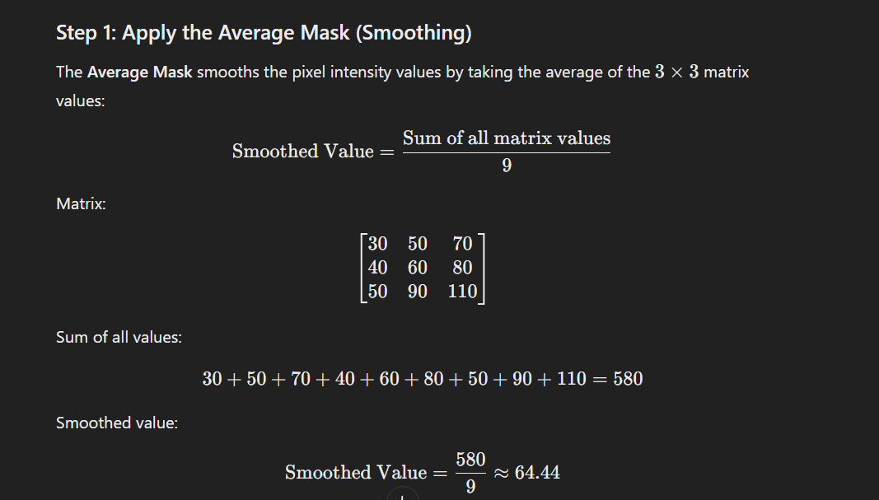
High boost filter steps

Slide 28
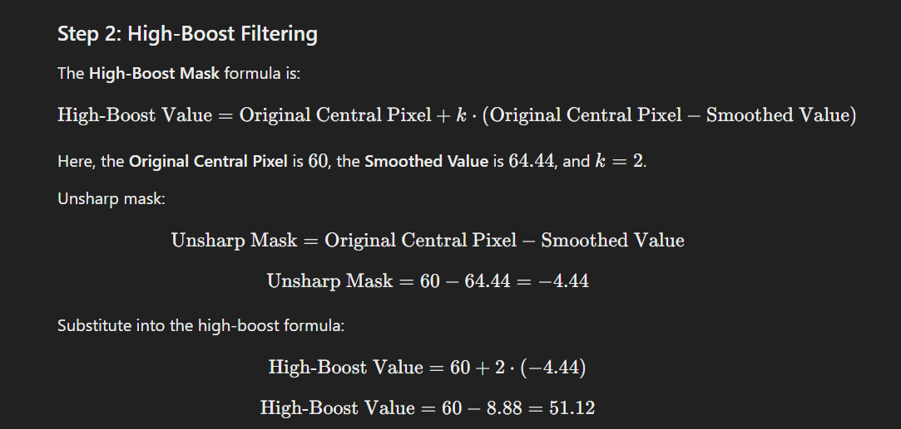

High boost filter steps

Slide 29
High boost filter steps

Slide 30
Soble & Gradient filter

Slide 31
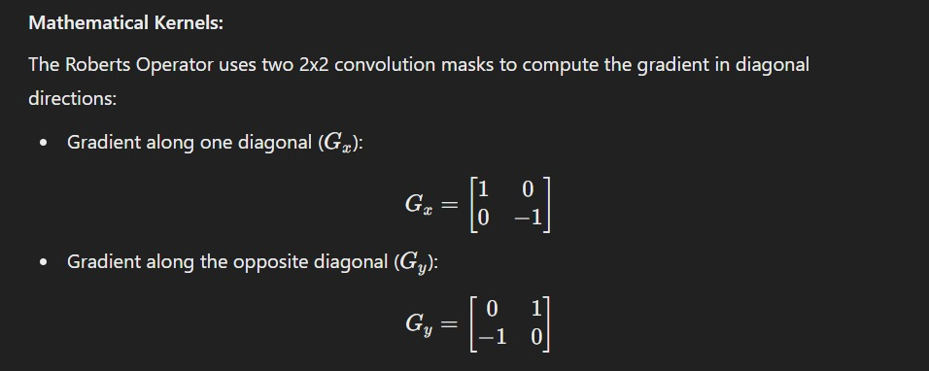
Gradient filter law

Slide 32
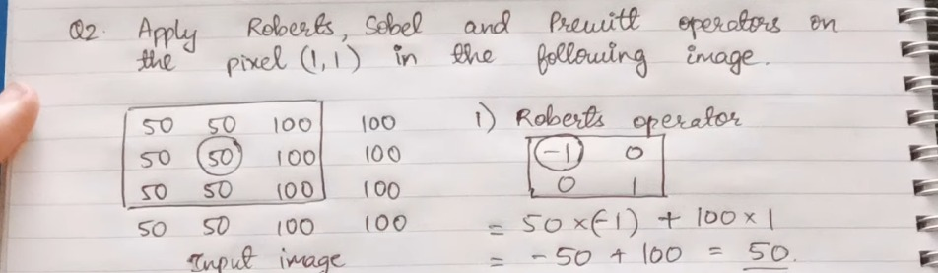
Gradient filter law

Slide 33
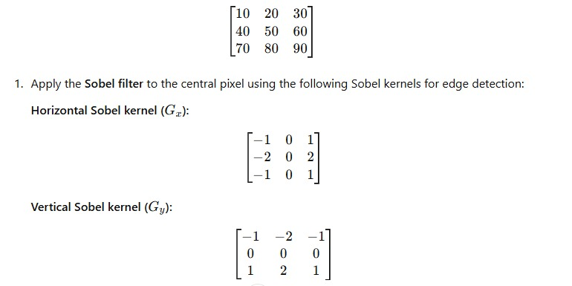
Sobel filter law

Slide 34
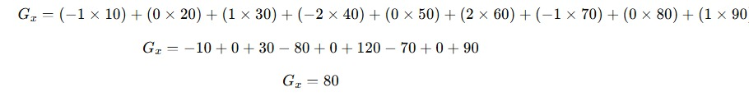
Sobel filter law
Horizontal

Slide 35
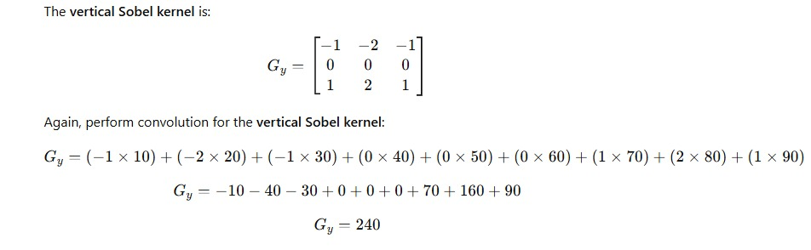
Sobel filter law

Slide 36
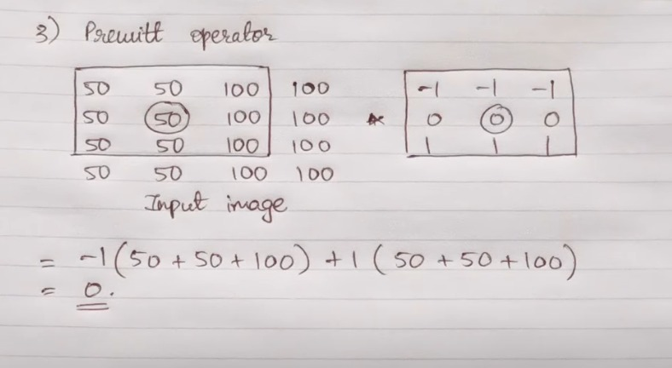
Pruitt filter Example

Slide 37
THANK YOU
Our Team
Ahmed Ismail
Badr Alwgood
Abdulrhman Khaled
Abdulrhman Amr
Momen Ameer
Amr Khaled

Slide 38

THANK YOU

